Slide 1





MobiRT: An Implementation of OpenGL ES-based CPU-GPU Hybrid Ray Tracer for Mobile Devices
Jae-Ho Nah, Yoon-Sig Kang,
Kwang-Jo Lee, Shin-Jun Lee,
Tack-Don Han, Sung-Bong Yang
Yonsei University, Korea
Notes:
Hello, my name is Jae-Ho Nah. I’m a ph.d candidate at Yonsei university.
Through this presentation, I’d like to talk about an implementation of OpenGL ES-based CPU-GPU hybrid ray tracer for mobile devices.
This MobiRT projcet has been co-authored with Yoon-Sig Kang, Kwang-Jo Lee, Shin-Jun Lee, Tack-Don Han, and Sung-Bong Yang.

Slide 2

Contents
Motivation and goals
Problems and solutions
Performance
Secondary rays
Texture mapping
Experimental results
Conclusions and future work
Notes:
My presentation is divided into four parts: the motivation and goals, problems and solutions in mobile ray tracing, experimental results on an OpenGL-ES emulator, and conclusions and future work.

Slide 3
Contents
Motivation and goals
Problems and solutions
Performance
Secondary rays
Texture mapping
Experimental results
Conclusions and future work
Notes:
First, I will describe motivation of goals of this project.

Slide 4
Motivation
3D user interfaces (UI)
A key application of visualization on mobile devices
The difficulties of 3D UI design
Complex Shader programming
Low rendering performance of mobile GPUs
Notes:
Currently, 3D user interfaces is a key application of visualization on mobile devices.
In particular, the increasing popularity of touch-screen phones has accelerated the necessity of 3D UI.
However, 3D UI design in mobile environments is difficult to create due to complex shader programming and low rendering performance.

Slide 5
Motivation
Ray tracing [Whitted 1980]
A technique for generating an image by tracing the paths of lights
Widely used for off-line rendering
Ray tracing can be a solution for 3D UI
naturally supports global illumination effects
→generates high-quality images & simplifies Shader programming
Performance is inversely proportional to the pixel size.
supports flexible primitive types.
Notes:
We believe ray tracing could be one of the solutions for 3D UI.
This is a definition of ray tracing: a technique for generating an image by tracing the paths of lights.
Even though it is widely used for off-line rendering, we think it can be used for interactive rendering for 3D UI for several reasons.
First, ray tracing naturally supports global illumination effects such as reflection, refraction, and shadows.
Therefore, it not only generates high-quality images, but also simplifies shader programming for these effects.
Next, ray tracing performance is inversely proportional to pixel size.
So it has advantages for small screen mobile devices.
Finally, ray tracing supports flexible primitive types, so more elaborate 3D objects can be rendered with fewer number of primitives.

Slide 6
Goals
Implement an OpenGL ES-based CPU-GPU hybrid ray tracer
Support full Whitted ray tracing
(reflections, refractions, hard shadows)
Support dynamic scenes
Notes:
In this work, we aimed at implementing OpenGL ES-based CPU-GPU hybrid ray tracer. This ray tracer should support full Whitted ray tracing of dynamic scenes for 3D UI.

Slide 7
Contents
Motivation and goals
Problems and solutions
Performance
Secondary rays
Texture mapping
Experimental results
Conclusions and future work
Notes:
From now, I will analyze three problems in implementing OpenGL-ES based ray tracer.
After that, I will present solutions of these problems.

Slide 8
Problems to Solve
Performance
Mobile GPUs have much poorer performance than
desktop GPUs
Secondary rays
OpenGL-ES 2.0 doesn’t support multiple render targets (MRTs) → only in the extension specification
Management of the ray tree is limited on the GPU.
Texture mapping
Ray tracing requires access of the entire scene data.
# of textures in the entire scene
> # of multi-texture units in the GPU
Notes:
There are three obstacles to overcome in implementing an OpenGL ES-based ray tracer.
First, mobile GPUs have much poorer performance than desktop GPUs, so the implementation of real-time ray tracing is NOT straightforward.
The second problem is dealing the secondary rays. OpenGL-ES 2.0 doesn’t support multiple render targets (in short, MRTs) and it is only defined in the extension specification. So the management of the ray tree, for the secondary rays, is limited on GPU.
The last problem is about texture mapping. Ray racing requires access of the entire scene data in contrast to rasterization. So the number of textures in the entire scene is constrained by the number of multi-texturing units in the GPU. the number of multi-texture units in current mobile GPUs is from 8 to 16.

Slide 9
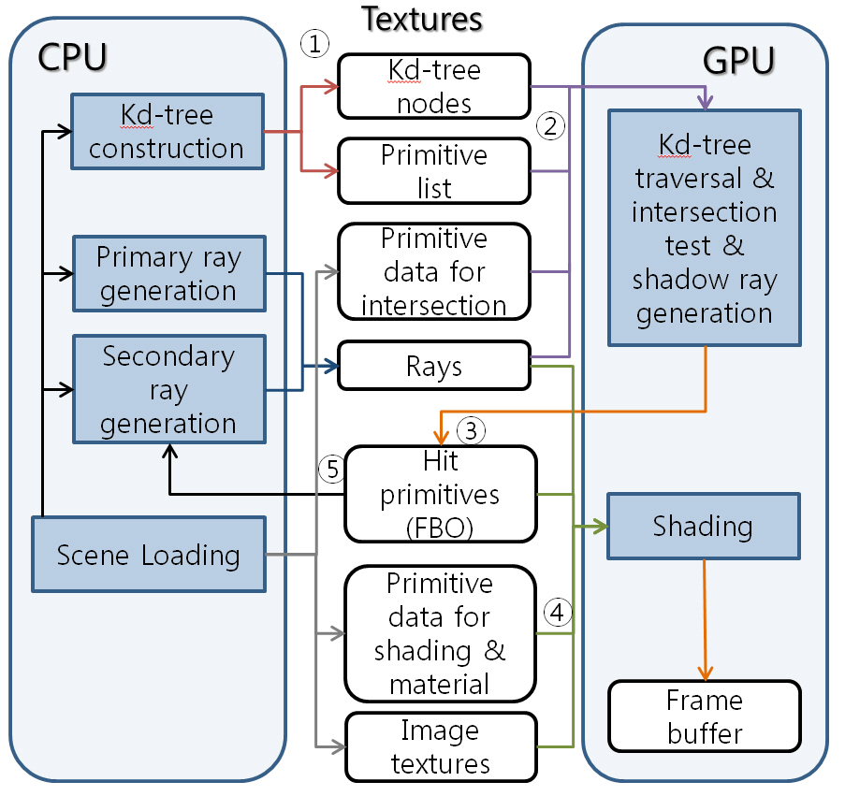
Solution for Performance
Exploit the availability of CPU and GPU architectures
Kd-tree build on CPU
- Binned SAH approximation [Shevstov et al. 2007]
Ray traversal on GPU
- Short-stack algorithm
[Horn et al. 2007]
Notes:
IN this research, we propose some solutions for these three problems.
First, for the performance problem, we exploit the availability of CPU and GPU architectures. In animated ray tracing, the performance for both ray tracing and acceleration structures updates is quite important. So we assign the updating acceleration structures to CPU and ray traversal to GPU.
Among the various acceleration structures, we chose the kd-tree because of its fast traversal performance.
This kd-tree is rebuilt from scratch for each frame using the fast binned surface area heuristic approximation.
For kd-tree traversal on GPU, we used the short-stack algorithm to keep the traversal stack in register, not in Random Access Memory.

Slide 10
Solution for Secondary Rays
32-bit compact output format
Ray traversal kernel
- 24bits : primitive index
- 8bits : shadow results
Shading kernel : 32bit RGBA
CPU manages
- Ray tree for secondary rays
- Hit points, normals, texture coordinates for shading
Notes:
For the Secondary ray problem, we use the compact 32-bit output format to overcome the limitation of memory writing on the GPU.
This output format consists of two types of data. In the case of the ray traversal kernel,
it outputs 24-bit hit primitive index and 8-bit shadow results.
In the case of shading kernel, the output is 32bit RGBA color.
After the GPU finishes a ray traversal pass, these hit and shadow results are transferred to the CPU using a frame buffer object.
The CPU then calculates hit points, normals, as well as texture coordinates.
These results are used for both the secondary ray generation on the CPU and shading on the GPU.

Slide 11
Solution for Texture Mapping
Apply texture atlases
[NVIDIA 2004]
16 textures (<=512x512 size) → 1 global texture (2,048x2,048 size)
Support variable size textures
Notes:
Now for the texture mapping, we apply texture atlases to the shading kernel.
In this method, 16 local textures not exceeding 512x512 resolution are integrated into one global texture with 2048x2048 resolution.
To support variable size textures including non-square textures,
the widths and heights of each texture are stored in the arrays and transferred to the GPU using glUniformMatrix.
The shading kernel then recalculates the actual texture coordinate.

Slide 12
Contents
Motivation and goals
Problems and solutions
Performance
Secondary rays
Texture mapping
Experimental results
Conclusions and future work
Notes:
Next, experimental results will be presented.

Slide 13
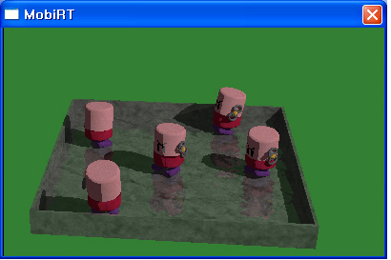
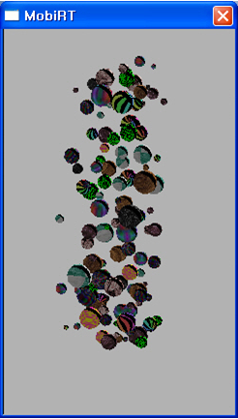
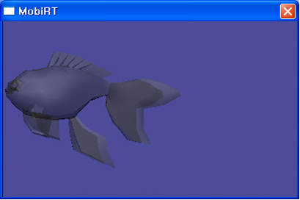
Test Setup
AMD OpenGL-ES emulator 1.4
2.9GHz AMD Athlon-X2, 2GB RAM, NVIDIA Geforce 9800GT
Benchmark scenes
Toaster (11K tris.)
Marbles
(8K tris.)
Fish (1.4K tris.)
Notes:
We used the AMD OpenGL ES Emulator 1.4 to evaluate our approach.
All tests were performed on a 2.9 GHz AMD Athlon-X2 with 2 GB DDR2 RAM and NVIDIA GeForce 9800GT.
We used a single thread for the kd-tree construction.
We selected three scenes as the benchmarks.
The first scene is the toaster with six image textures and a reflective material.
The second scene contains the marbles with 10 textures to test texture atlases.
The last scene has a fish with a refractive material.
We used a single light source in all the test scenes.
These figures show that the MobiRT, our proposed system, fully supports Whitted effects and texture mapping.
: Reflection, refraction, hard shadows, texture mapping with more than eight textures.
We prepared not only captured images but also a video. The fish scene was excluded from this video because it is static.

Slide 14
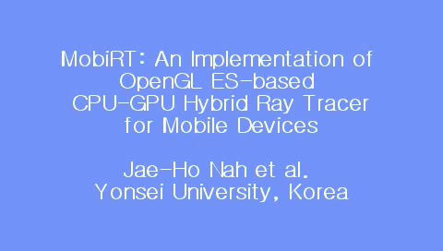
Video
AMD OpenGL-ES emulator 1.4
2.9GHz AMD Athlon-X2, 2GB RAM, NVIDIA Geforce 9800GT
Benchmark scenes
Notes:
We prepared not only captured images but also a video. The fish scene was excluded from this video because it is static.

Slide 15
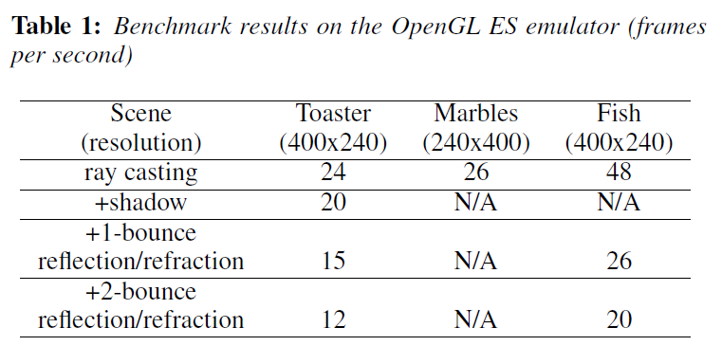
Results
We expect that the MobiRT will show 1-5 FPS on real mobile devices.
Notes:
This table depicts the benchmark results on the OpenGL ES emulator.
According this table, the rendering performance was from 12 to 48 frames per second,
and it was inversely proportional to the number of rays.
We expect that our MobiRT will show from 1 to 5 FPS on real mobile devices.

Slide 16
Contents
Motivation and goals
Problems and solutions
Performance
Secondary rays
Texture mapping
Experimental results
Conclusions and future work
Notes:
Finally, I will sum up this sketch.

Slide 17
Conclusions and Future Work
The implementation of an OpenGL ES-based CPU-GPU hybrid ray tracer
CPU : kd-tree build and management of the ray tree
GPU : kd-tree traversal, intersection tests, and shading
Supports full Whitted ray tracing of dynamic scenes.
Future work
Implementation on real mobile devices
Using OpenCL for faster and more efficient ray tracing
Notes:
We proposed an OpenGL ES-based CPU-GPU hybrid ray tracer for mobile devices.
In this ray tracer, a CPU manages tree build and ray tree, and a GPU performs tree traversal, intersection test, and shading.
This ray tracer supports animated ray tracing with full Whitted effects.
In future studies, we would like to implement our ray tracer on actual mobile devices.
Also, we think the use of OpenCL will provide faster and more efficient ray tracing.

Slide 18
Acknowledgements
This work was supported by Samsung Electronics Co., Ltd.
Notes:
This work was supported by the Samsung Electronics.
Thank you for listening to my presentation.

Slide 19

Q&A
Notes:
If you have any questions, I’d be happy to answer.

